Slide 1

Project presentation
Early and late genome-wide gastric epithelial transcriptome response during infection with the human carcinogen Helicobacter pylori
Irshad et al, 2022
Pham Thi Hong Dao

Slide 2
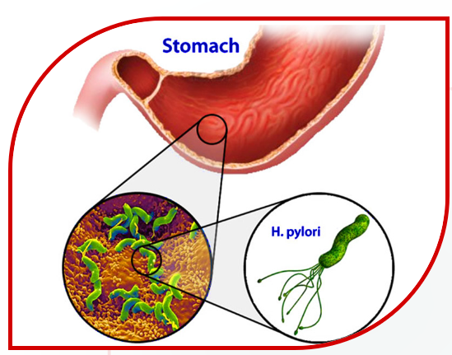
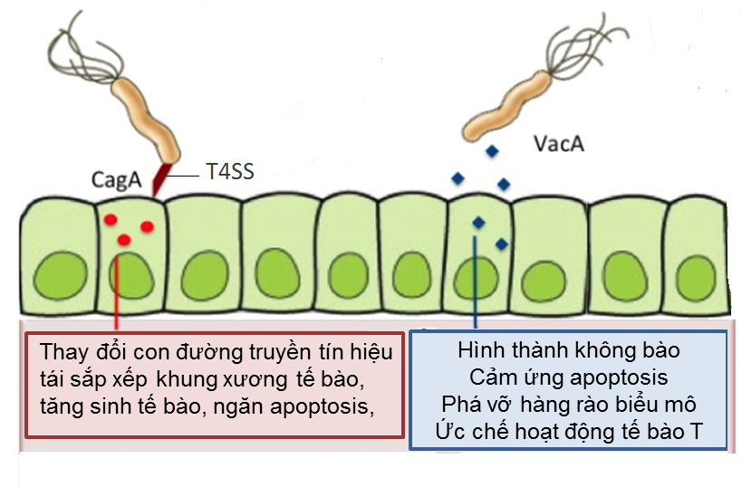
Introduction

E-cadherin
Claudin8
Occludin
HtrA
Chronic inflammation
DNA damage
Cell cycle
DNA repair systems
Apoptosis
HtrA (High temperature requirement A) serine proteases: both chaperone and proteolytic activities
HtrA affects the host cellular signaling upon H. pylori infection of gastric cells remains widely unclear
Gastritis
Peptic ulcer
Gastric cancer

Slide 3
Research Objectives
To investigate the transcriptomic responses of MKN-28 gastric epithelial cells to Helicobacter pylori infection using genome-wide RNA-seq analysis. Gene expression profiles were compared between:
Wild-type and ΔhtrA mutant H. pylori strains
Early (2 h) and late (6 h) time points

Slide 4
Methods
Infect MKN-28 cells with H. pylori
ANALYSIS WORKFLOW
Library preparation
Sequencing
Illumina, single-end
DGE QC analysis
Quality control (QC)
Differential expression analysis
DESeq2
Trimming
cutadapt
Mapping STAR aligner
Ref genome GRCh37 (FASTA) + GTF file
Pathway analysis
GO, KEGG,..
Experimental Validation
RT-qPCR, Apoptosis assay,…
Aligment QC
Counting
featureCounts

Slide 5
Methods
colData
20 samples
Mock (Ctrl)
Hpwt_2h
Hpmut_2h
Hpwt_6h
Hpmut_6h
Performed in quadruplicate
countData

Slide 6
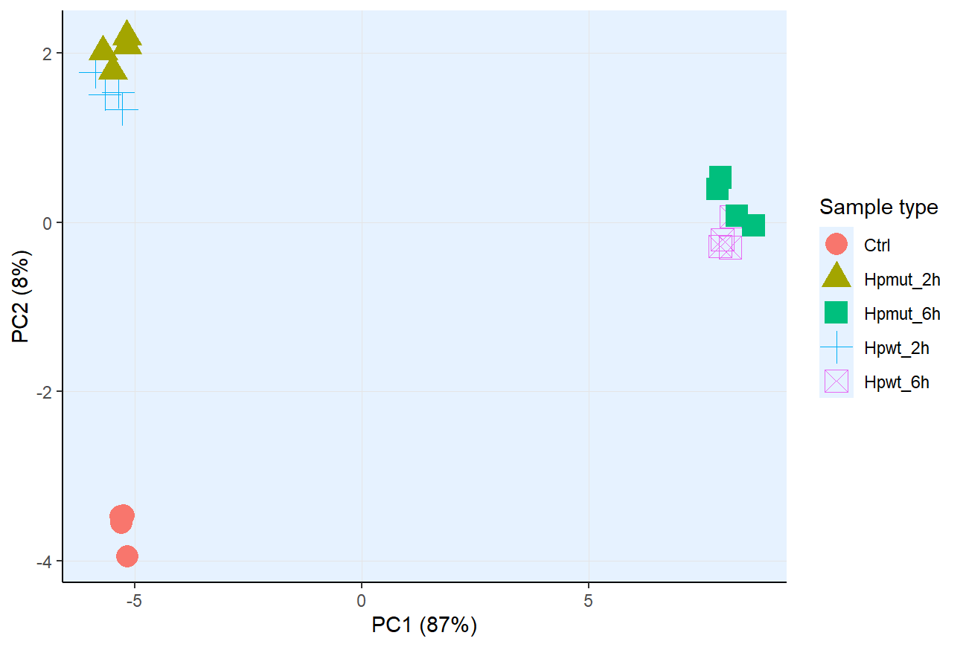
Results - DGE QC analysis
Principle component analysis (PCA)
Distinct difference between the uninfected control and cells infected
Notes:
Gene-level QC

Slide 7
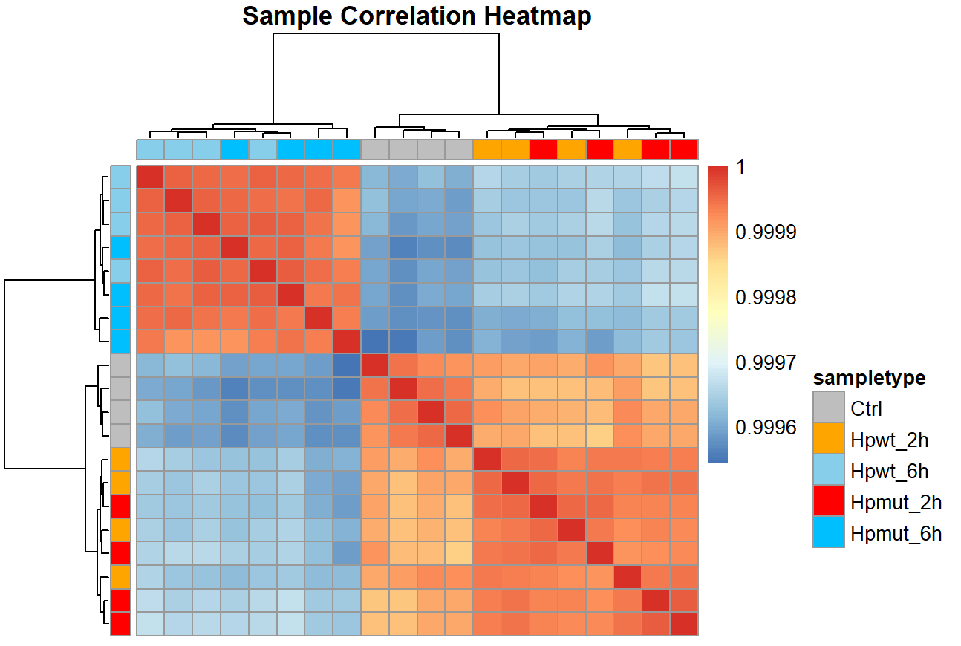
DGE QC analysis
Hierarchical Clustering Heatmap
Sample-to-sample heatmap of rlog transformed read counts in uninfected MKN-28 cells (Ctrl), MKN-28 infected with H. pylori wt or ΔhtrA mutant bacteria for 2 or 6 hours.

Slide 8
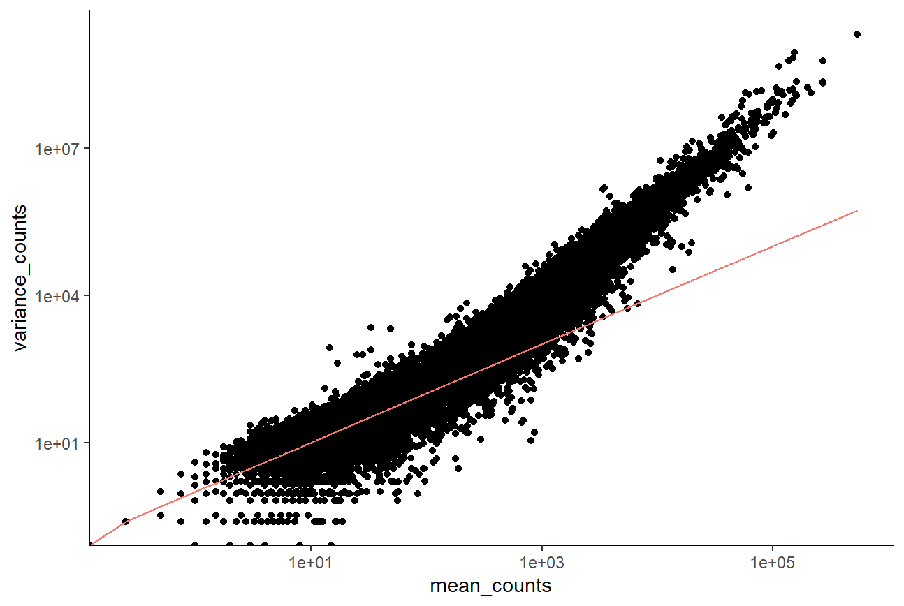
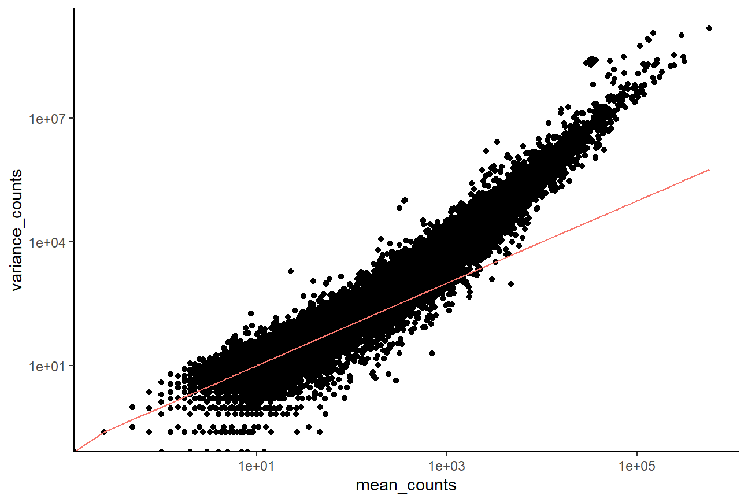
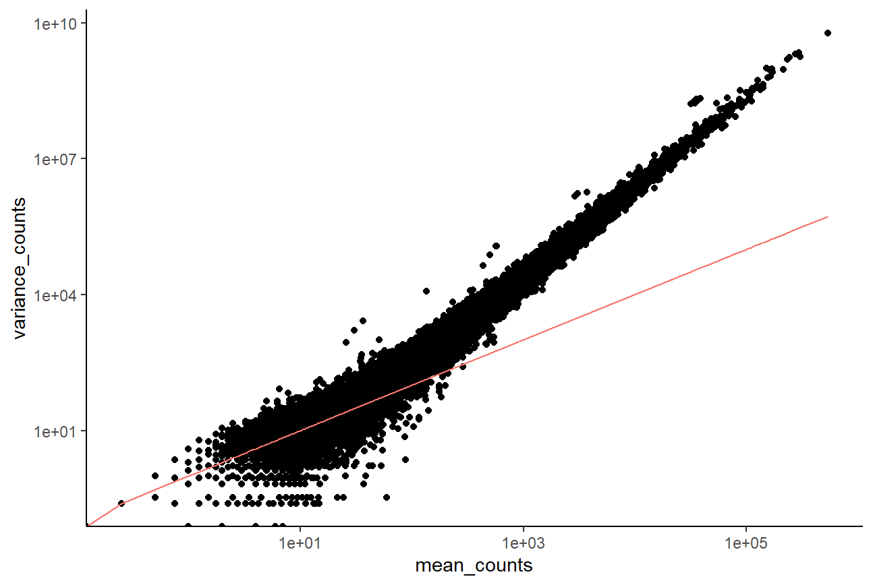
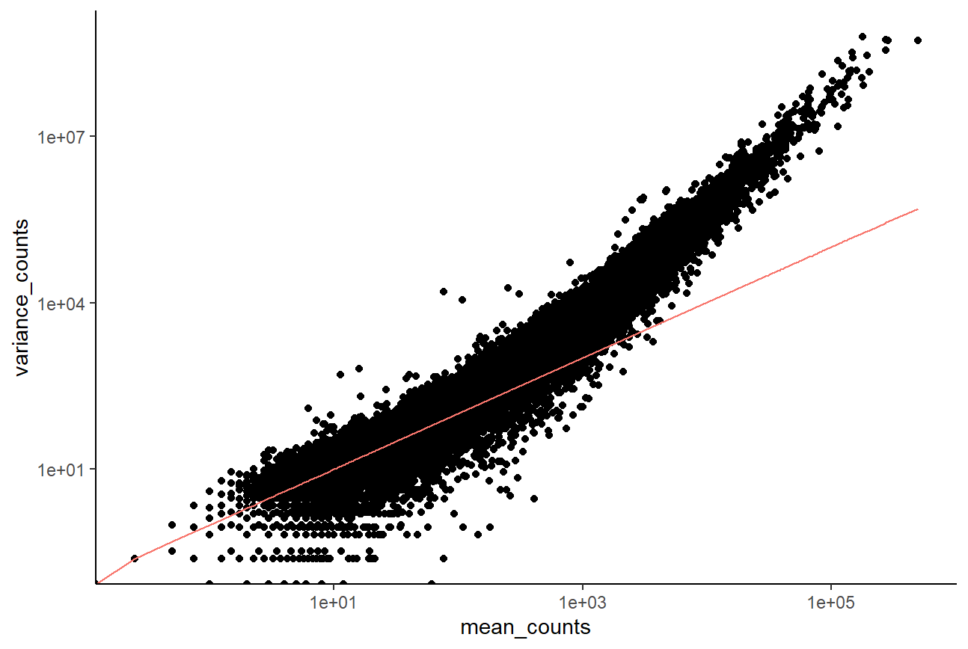
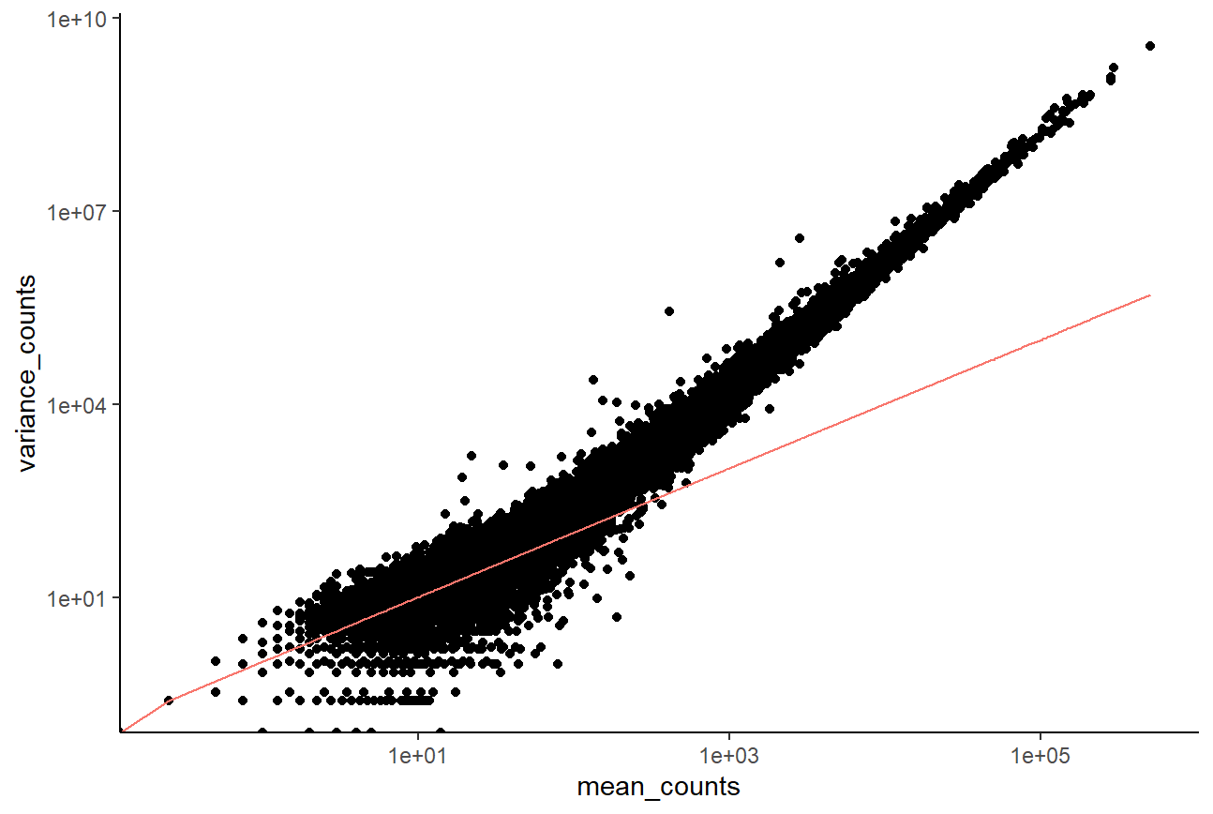
Differential expression analysis
Modeling count data
Ctrl
Hpwt_2h
Hpmut_2h
Hpwt_6h
Hpmut_6h
Mean < Variance => using the Negative Binomial model

Slide 9
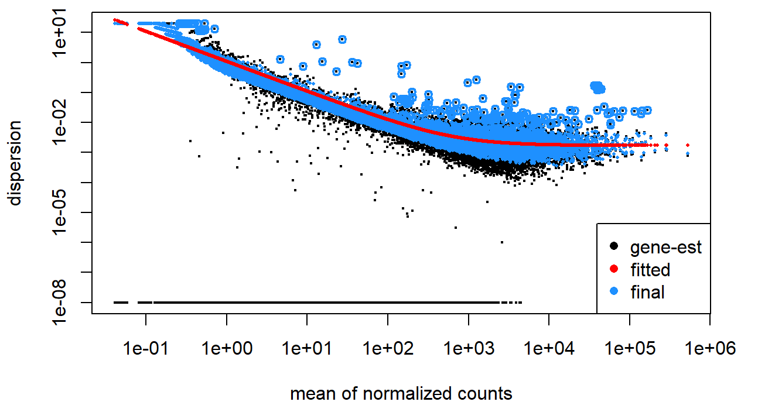
Differential expression analysis
Shrink gene-wise dispersion estimates toward the values predicted by the curve

Slide 10
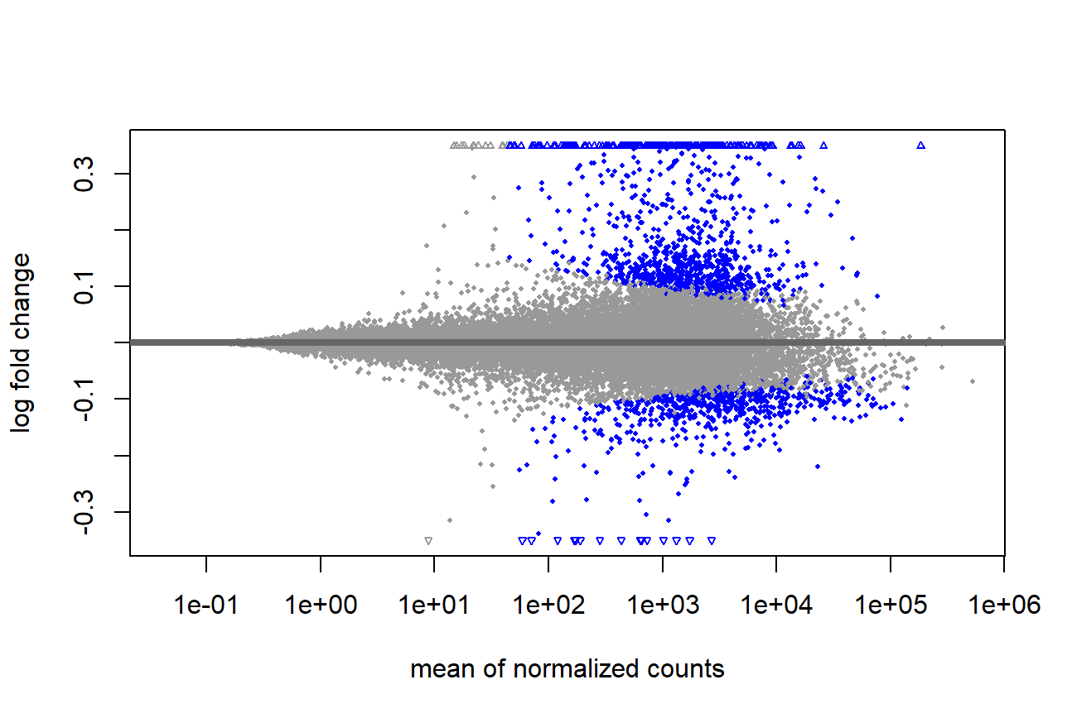
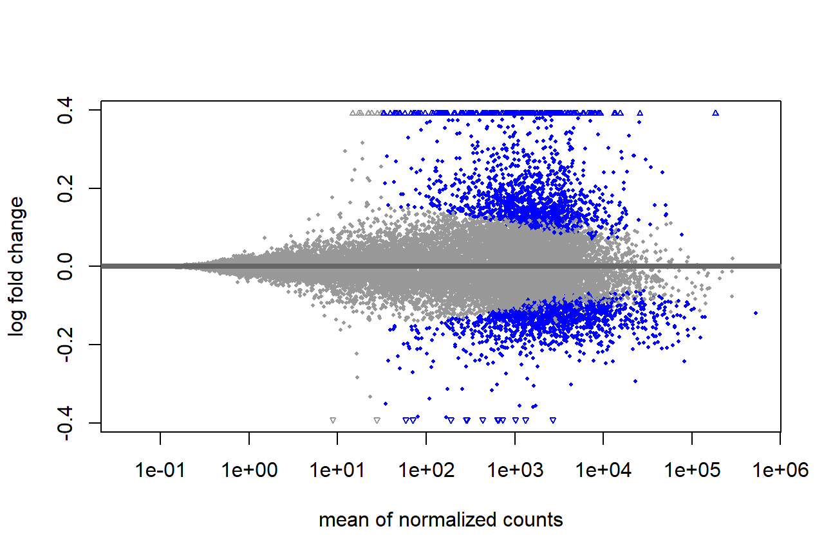
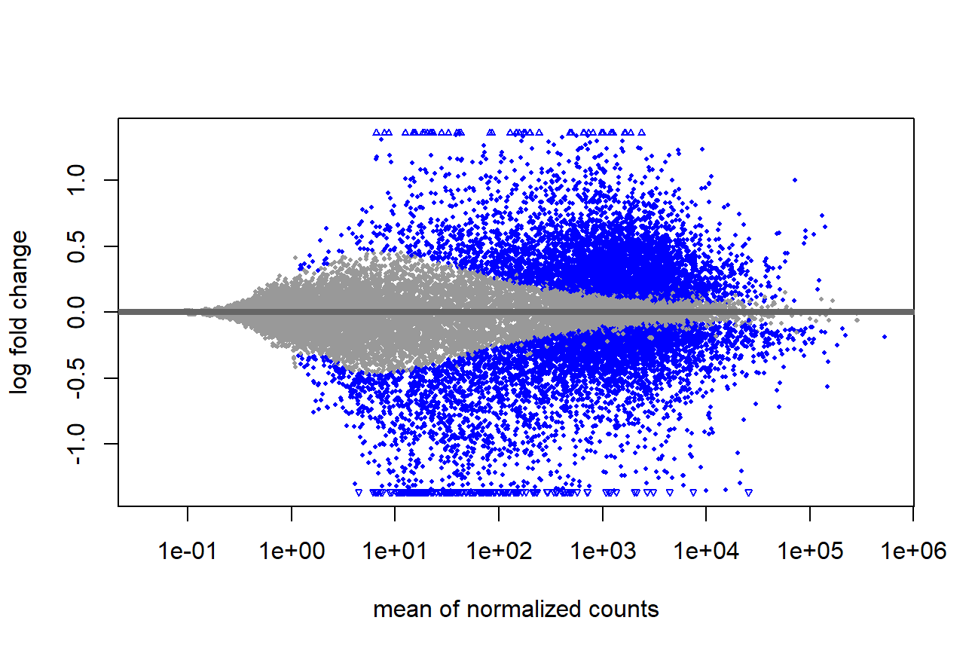
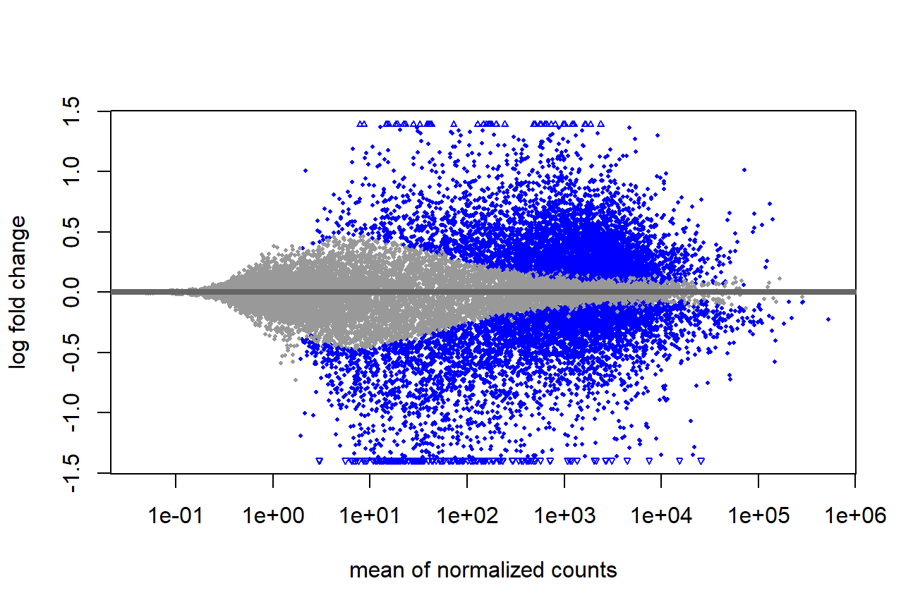
Differential expression analysis
Hpwt_2h
Up: 93 Down: 6
Up: 118 Down: 3
Hpmut_2h
library(ggplot2)
library(dplyr) library(ggrepel)
Up: 895 Down: 1283
Up: 990 Down: 1328
Hpwt_6h
Hpmut_6h
MA plot of gene expression profiles in MKN-28 cells after infection with either H. pylori wt or ΔhtrA mutant for 2 or 6 hours. DEG numbers after adjusting to p value < 0.05 and log₂ fold change of ≤ −0.58 or ≥0.58

Slide 11
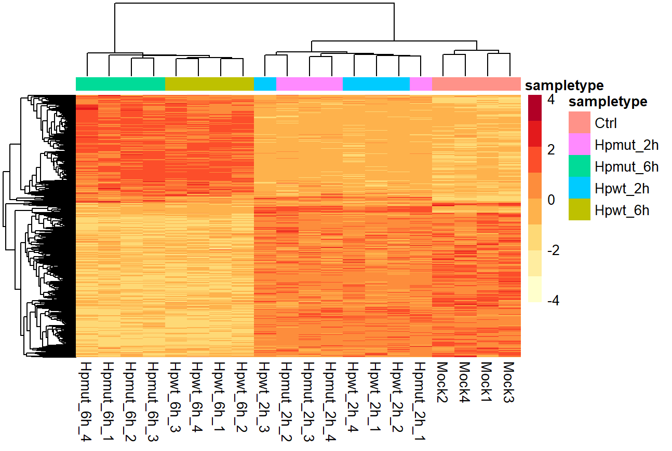
Differential expression analysis
library(ggplot2)
library(pheatmap)
Gene expression profiles of MKN-28 cells after infection with either H. pylori wt or ΔhtrA mutant for 2 or 6 h. Clustered heatmap of DEGs with a log₂ fold change of ≤ −0.58 or ≥ 0.58. L₂FC – log₂ fold change.

Slide 12
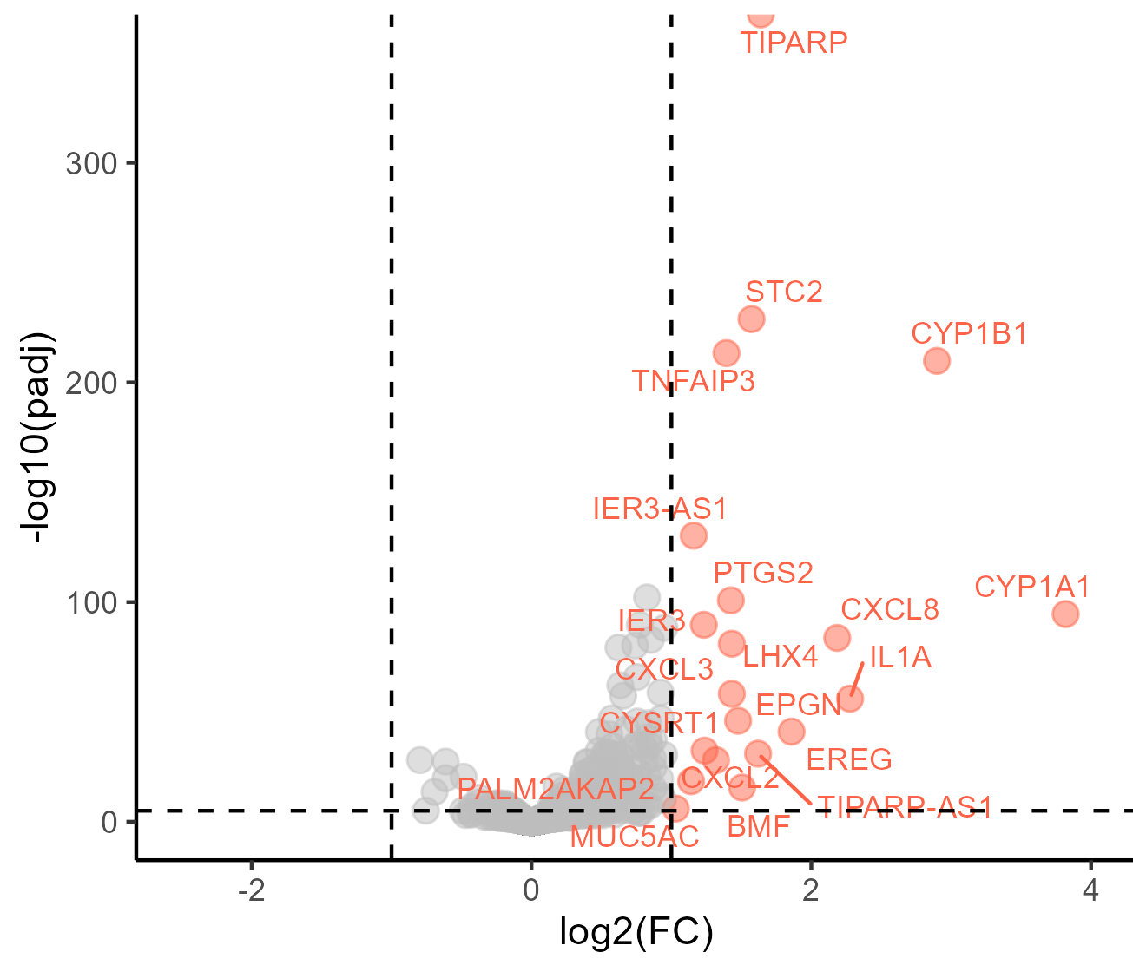
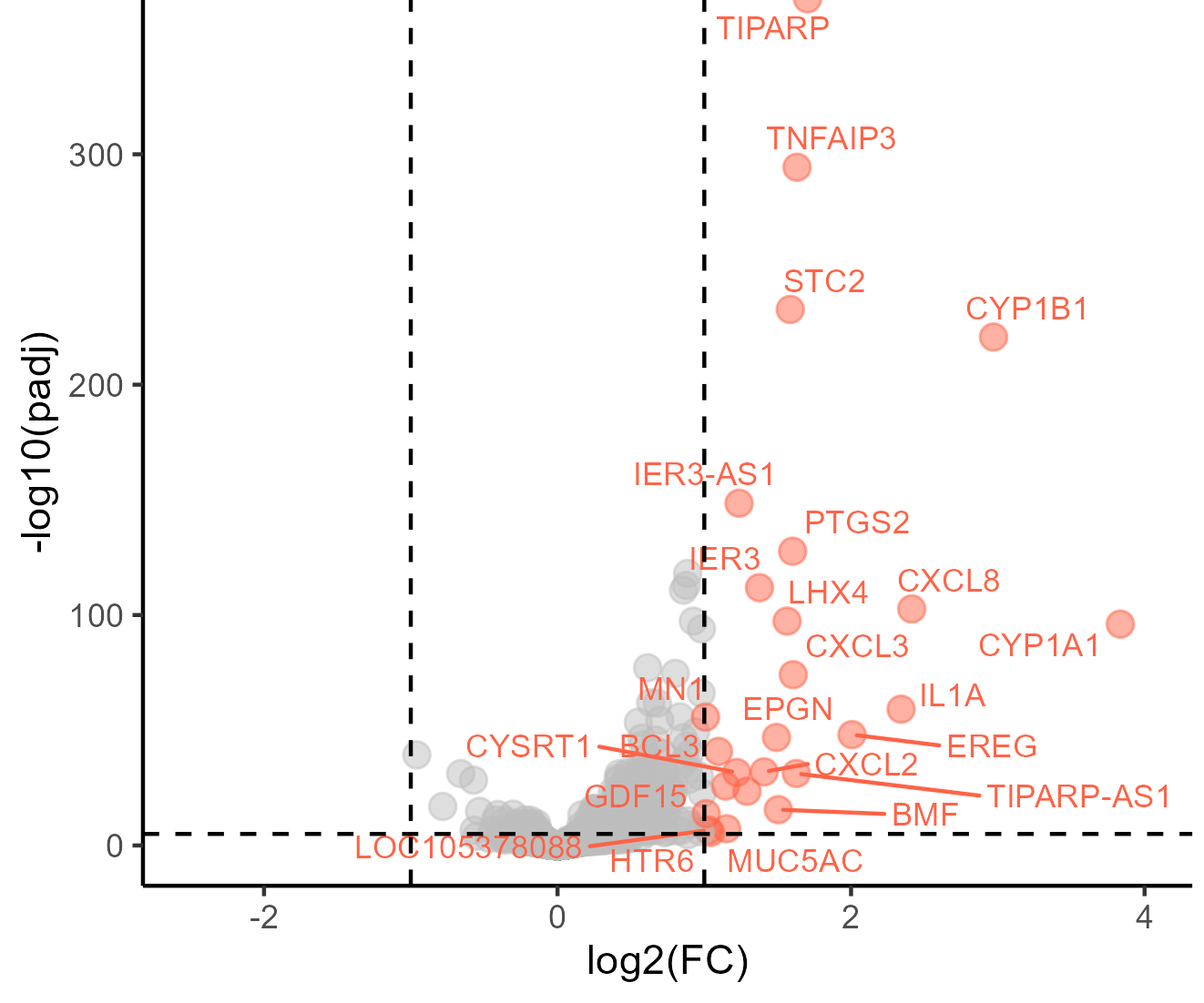
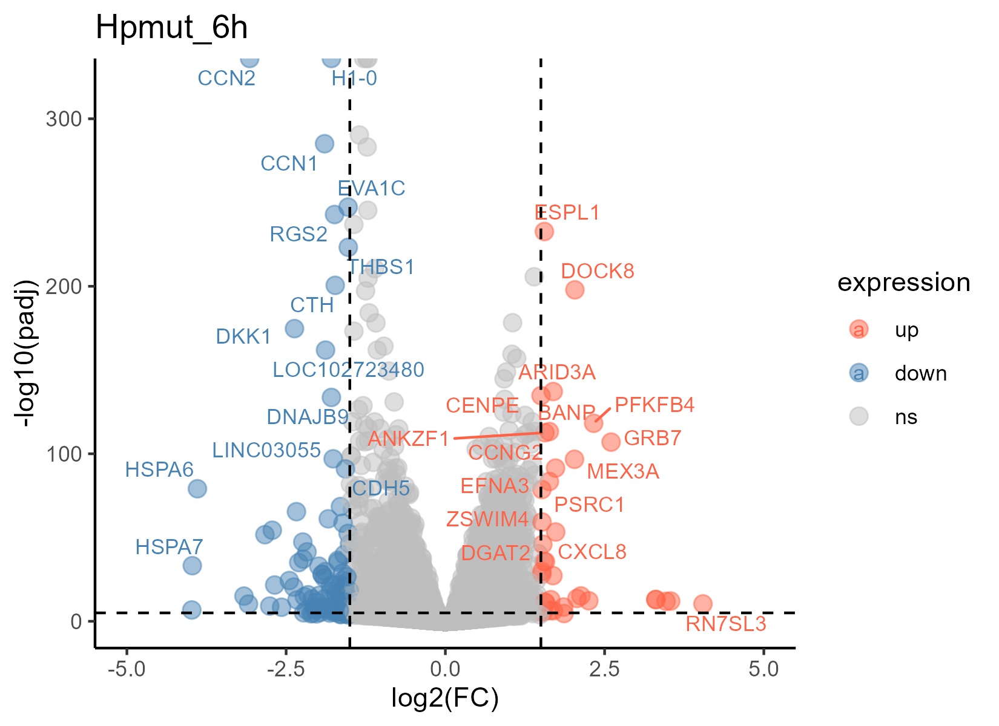
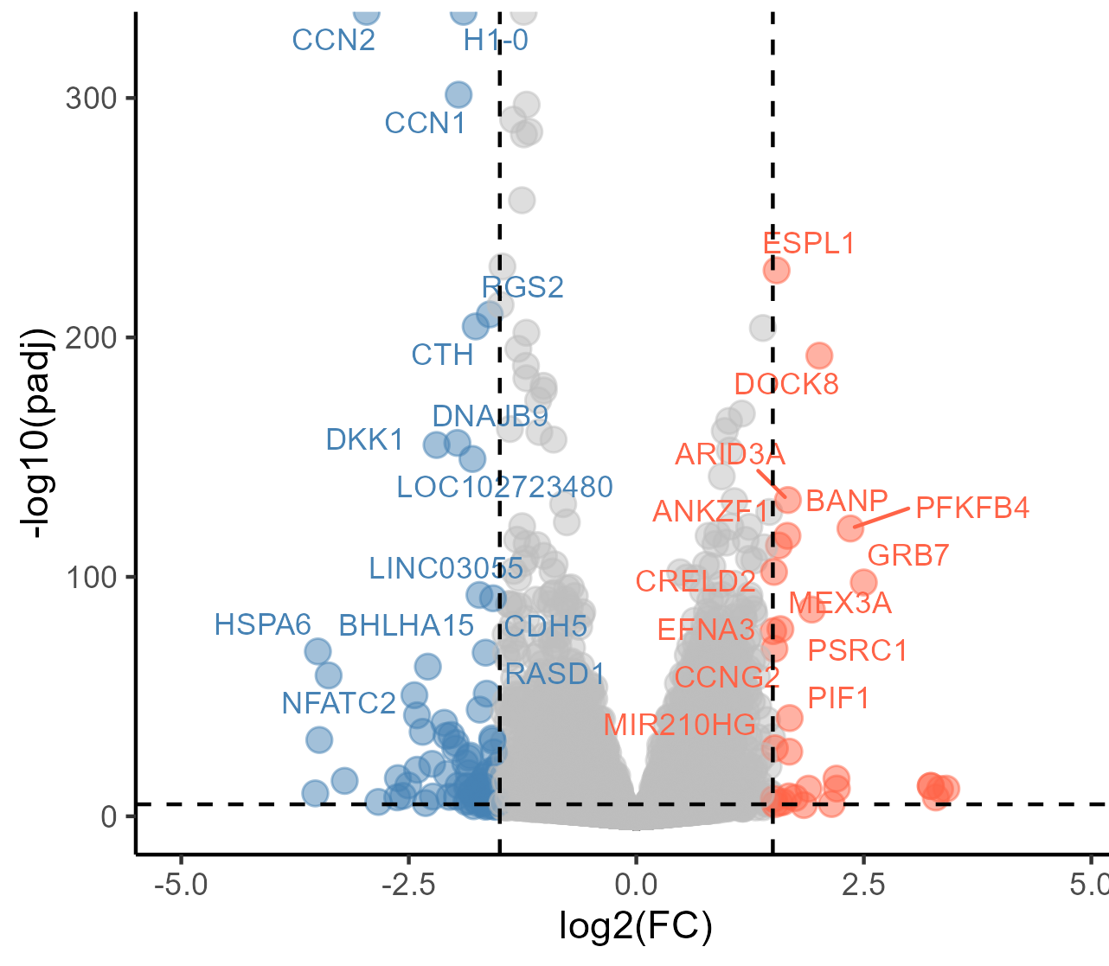
Differential expression analysis
Hpwt_2h
Hpmut_2h
Cut-off: p value = 10⁻⁵, absolute log₂ fold = 1
Hpwt_6h
Hpmut_6h
Cut-off: p value = 10⁻⁵, absolute log₂ fold = 1.5
The volcano plots of DEGs in MKN-28 cells after infection with H. pylori wt or ΔhtrA mutant for 2 or 6 h
library(ggplot2)

Slide 13
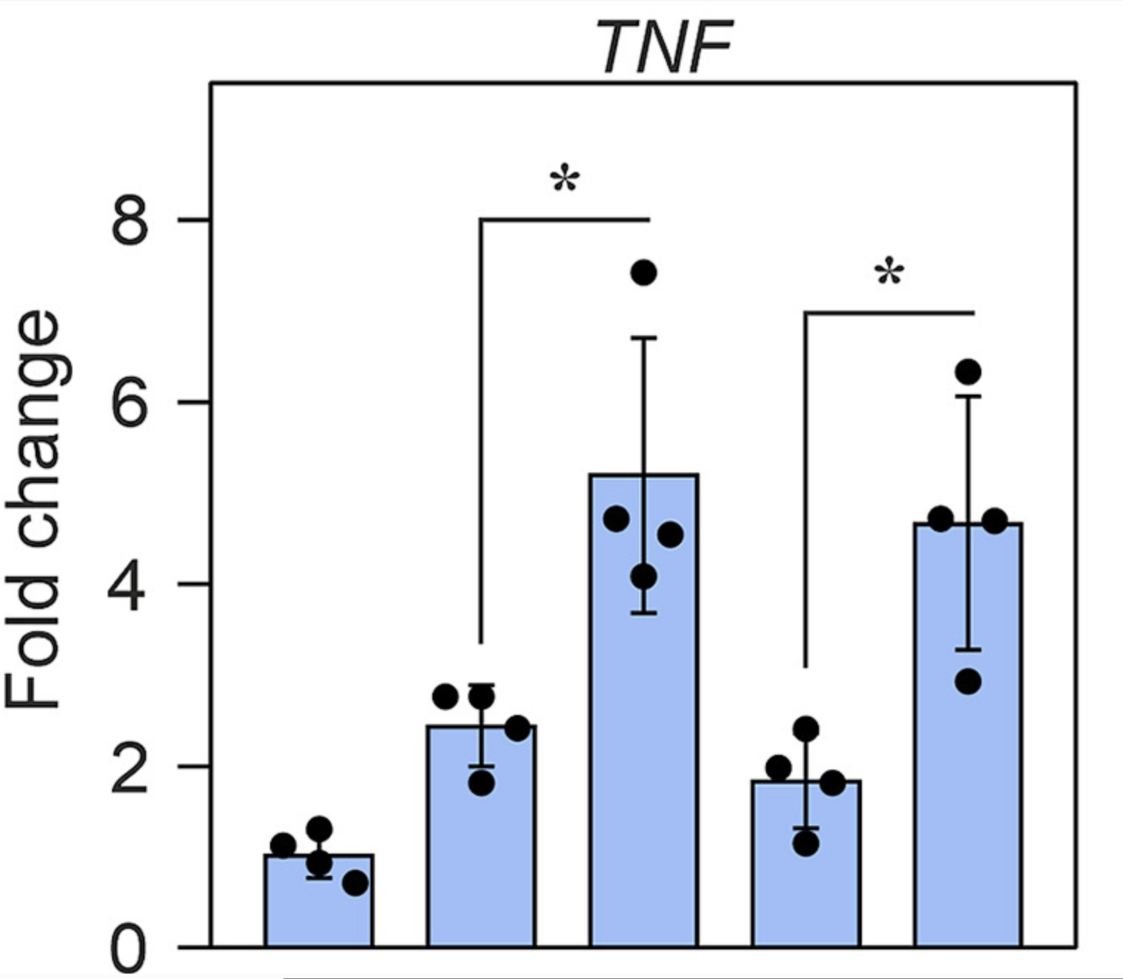
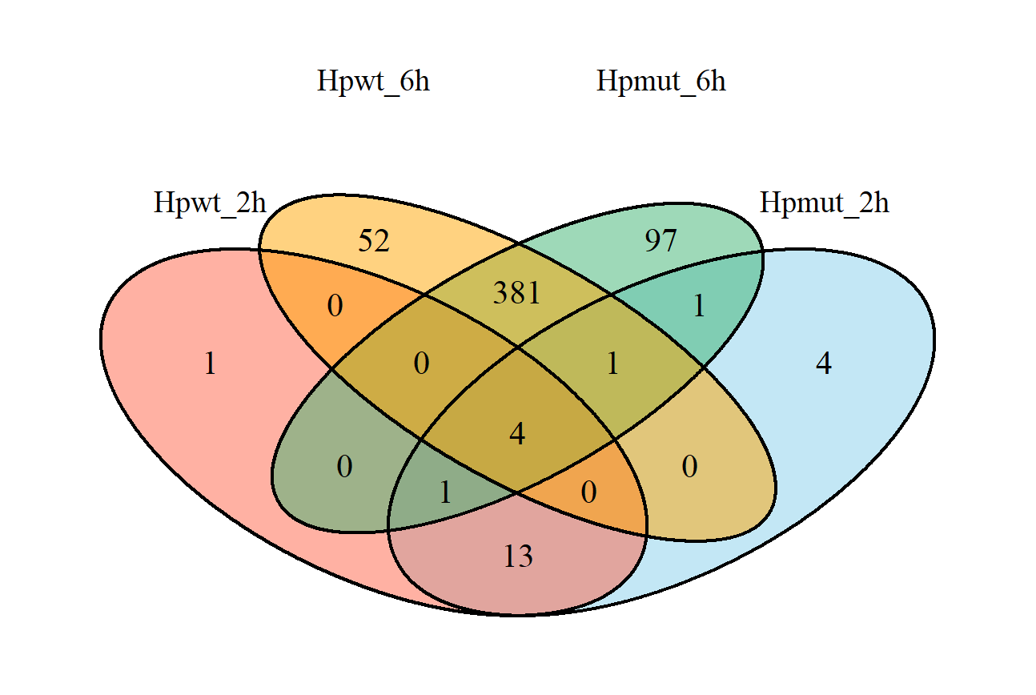
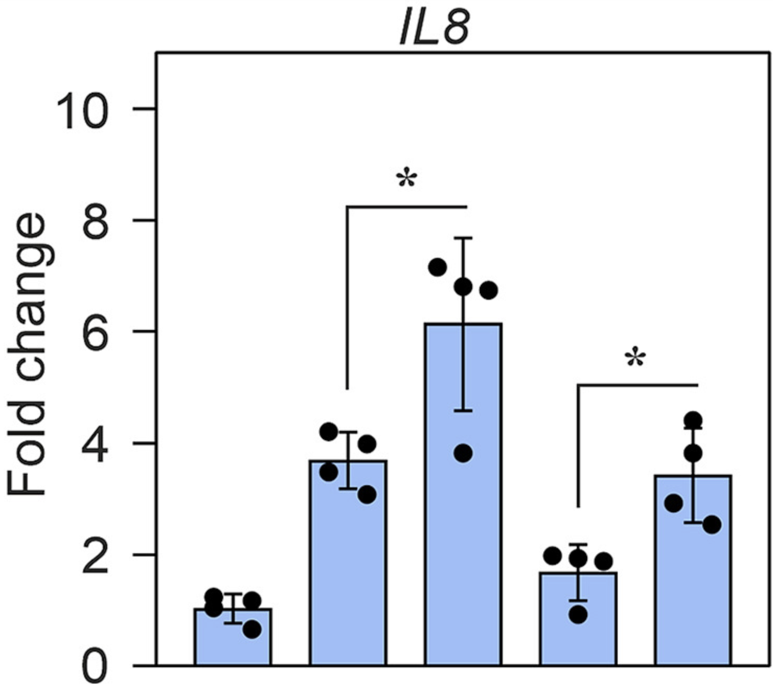
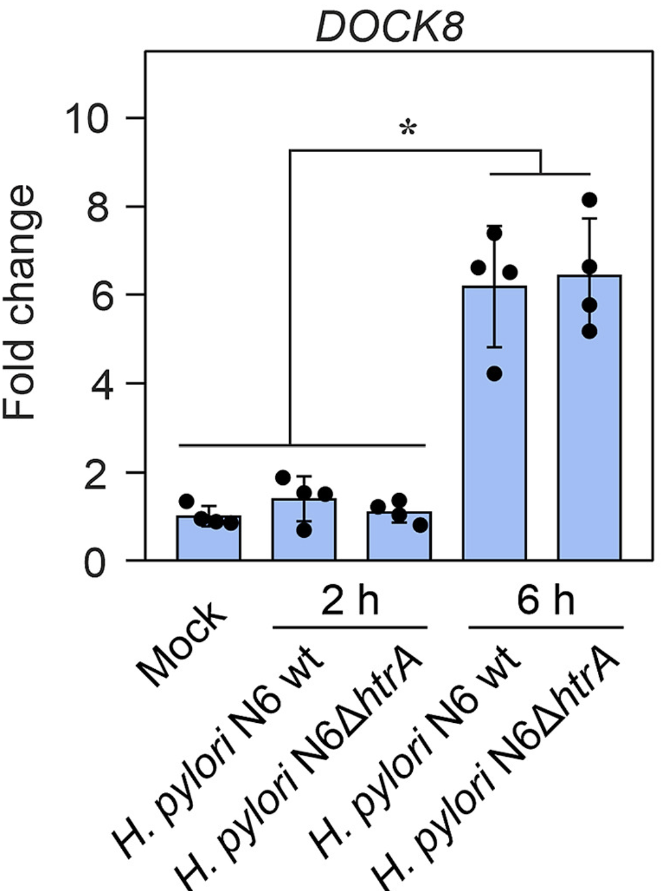
Differential expression analysis
A
B
n=438
n=485
HSPA, PFKFB4, DOCK8, MAP1B, GRB7, DKK1, NFATC2
n=19
n=24
TNF
PTGS2
IL8
PTGS2
C9orf169
A. Venn diagram representing the shared DEGs in different groups of MKN-28 infected by H. pylori wt or ΔhtrA mutant for 2 or 6 h (adjusted p value < 0.05, log₂ fold change of ≤ −1 or ≥ 1).
B. RT-qPCR of representative MKN-28 genes associated with affected inflammatory (IL8), apoptotic (TNF), and carcinogenic (DOCK8) pathways
library(VennDiagram) library(ggVennDiagram)

Slide 14
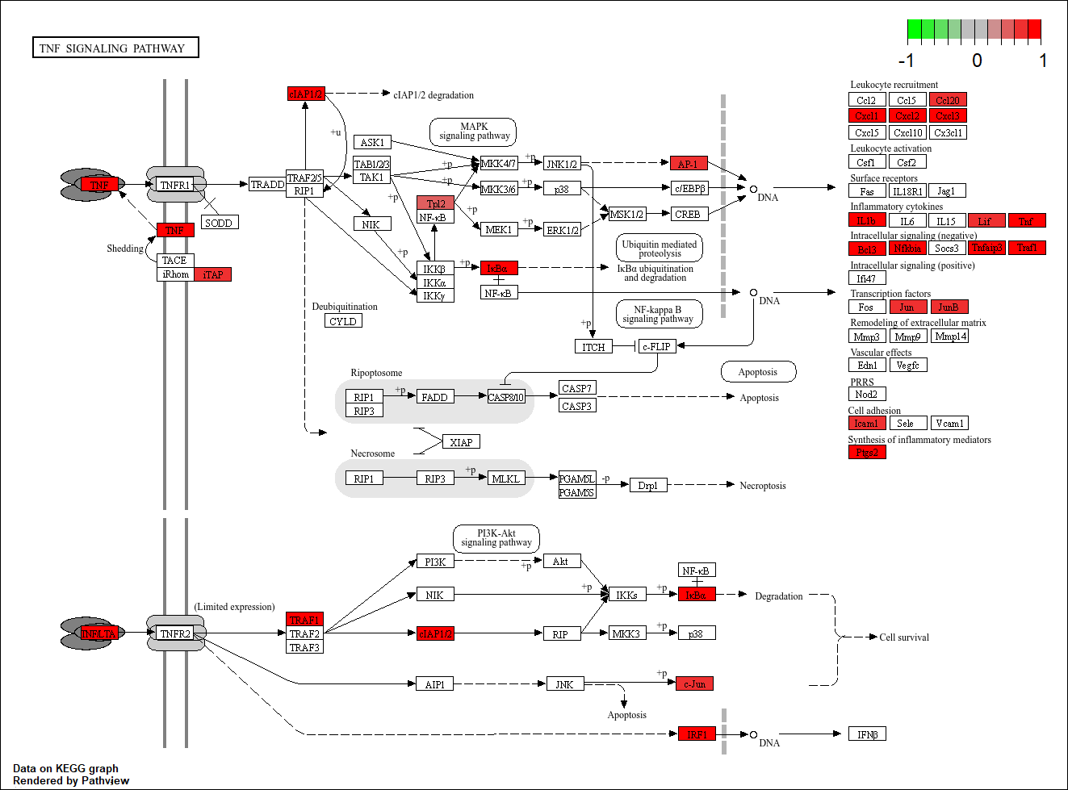
Differential expression analysis - Pathway analysis
library(pathview)
TNF signaling pathway (hsa04668) affected by H. pylori ΔhtrA infection for 2-h was enriched using the KEGG enrichment assay. Red and green colors reflect up- and down-regulation levels in log₂ fold change, respectively.

Slide 15
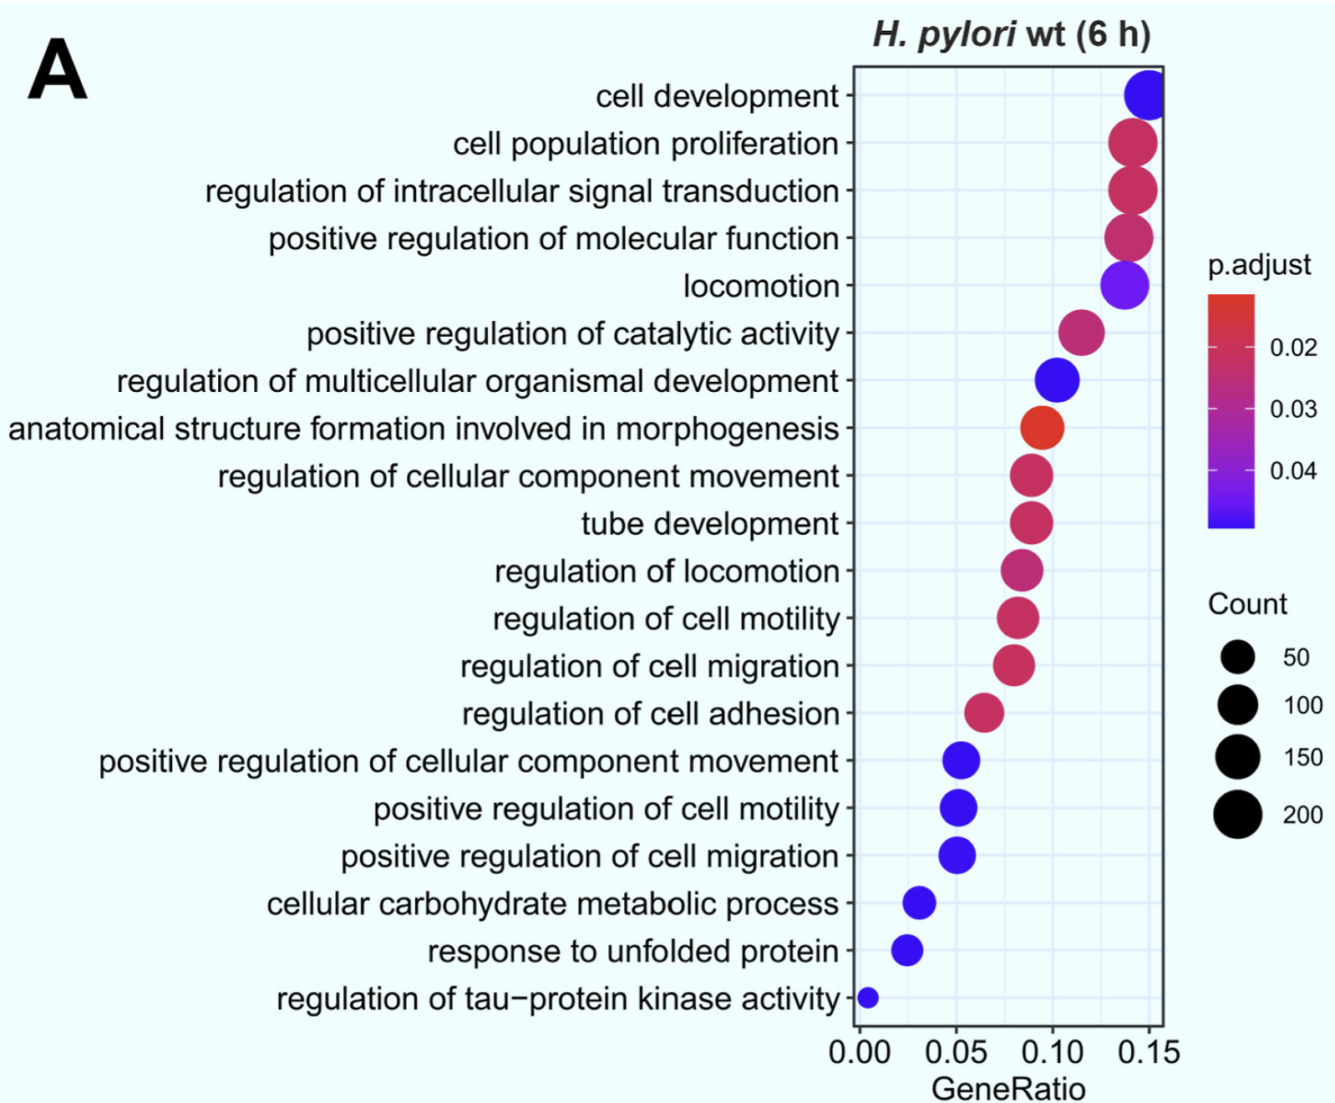
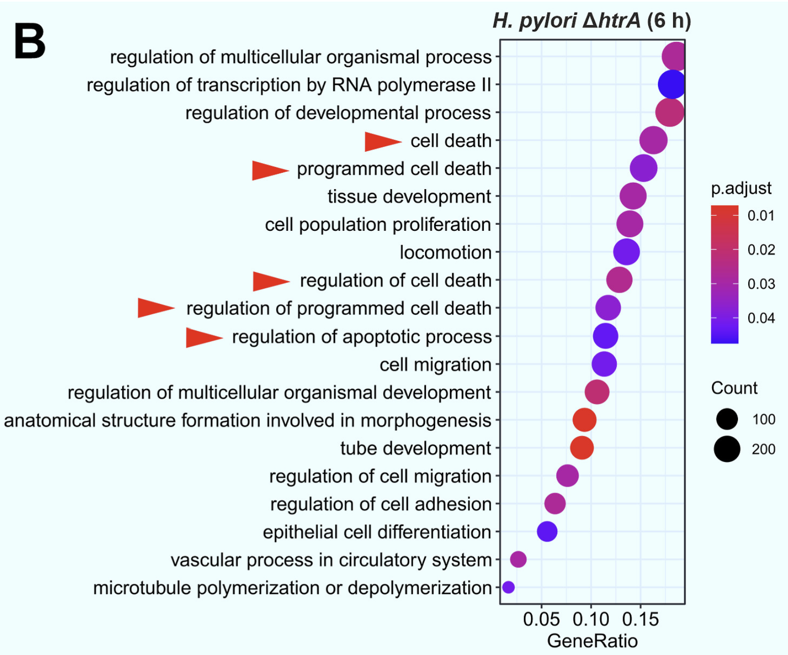
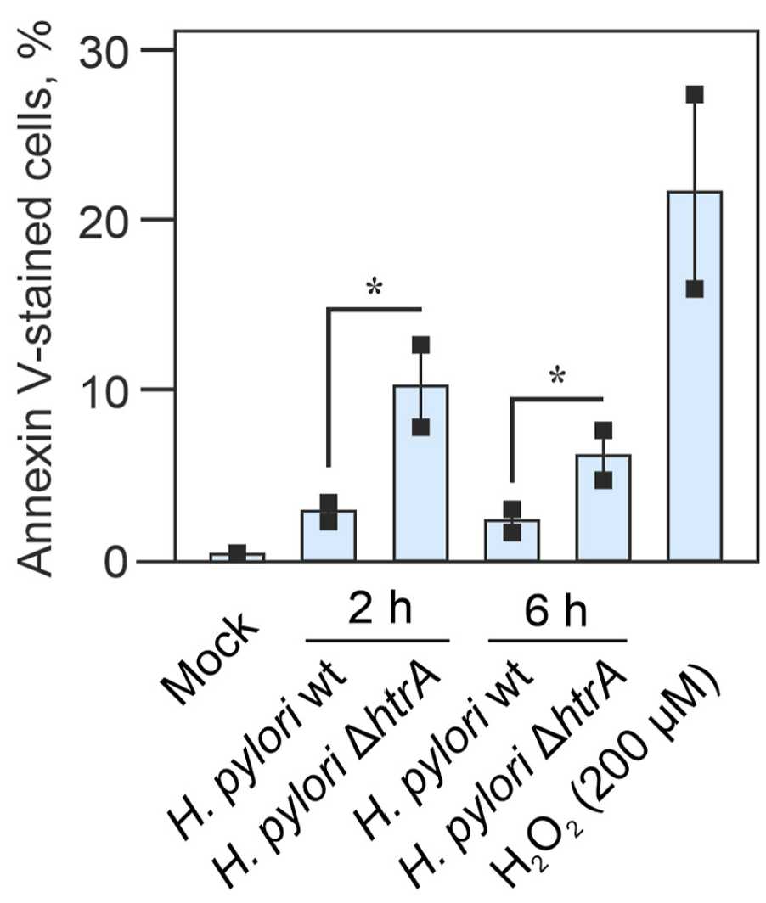
Differential expression analysis - Pathway analysis
Gene Ontology (GO) term enrichment of biological pathways in MKN-28 cells affected after 6-h infection with H. pylori wt (A) or ΔhtrA (B). (adjusted p value < 0.05, log₂ fold change < −0.58 or >0.58)
Quantification of annexin V-stained apoptotic cells as the percentage of total cells assessed by fluorescence/phase contrast microscopy.
library(clusterProfiler)
library(org.Hs.eg.db)
library(enrichplot)

Slide 16
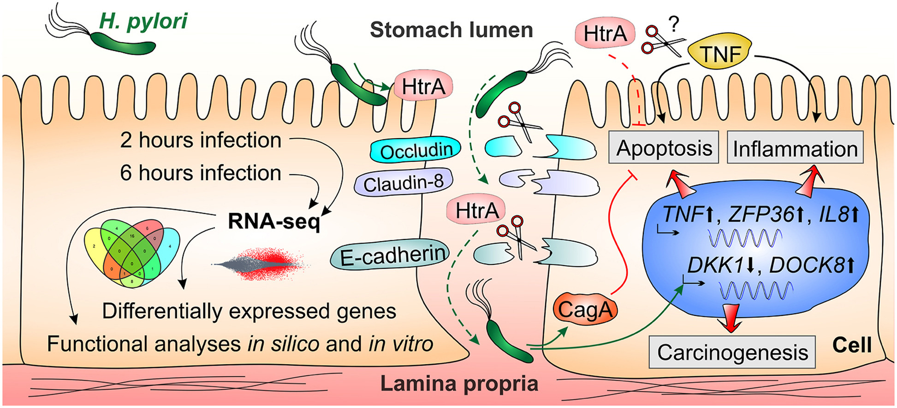
Conclusion
Most differentially expressed genes at 6 h post infection
The transcriptomes revealed HtrA-dependent targeting of genes associated with inflammation and apoptosis (e.g. IL8, TNF )
Transcription of various carcinogenesis-associated genes (e.g. DOCK8) was affected by H. pylori independent of HtrA
H. pylori disturbs previously unknown molecular pathways in an HtrA-dependent and HtrA-independent manner, and provide valuable new insights of this significant pathogen in humans

Slide 17

XIN CHÂN THÀNH CẢM ƠN SỰ HƯỚNG DẪN NHIỆT TÌNH CỦA THẦY VÀ CÁC BẠN!

Slide 18
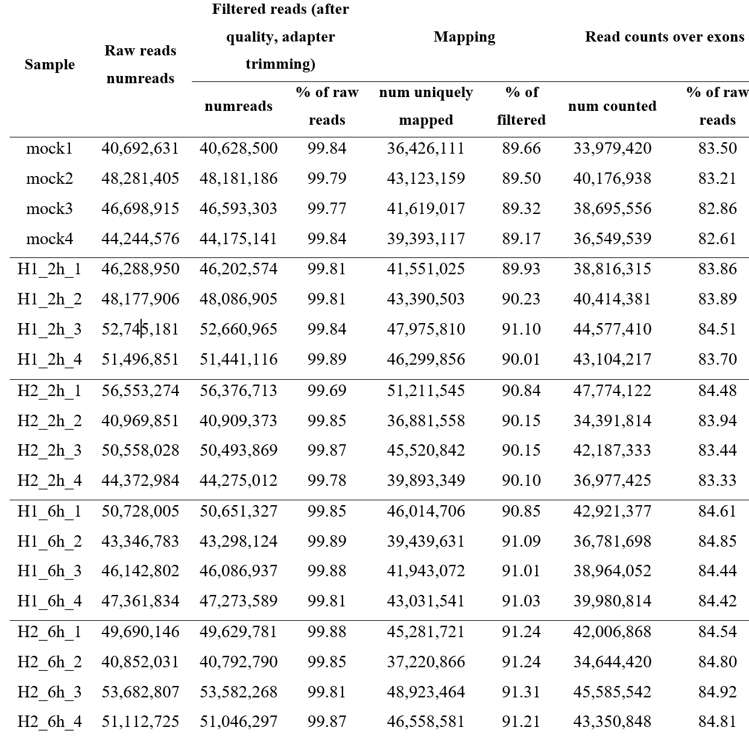
Table S1. Basic quality control of raw reads after RNA-seq.

Slide 19
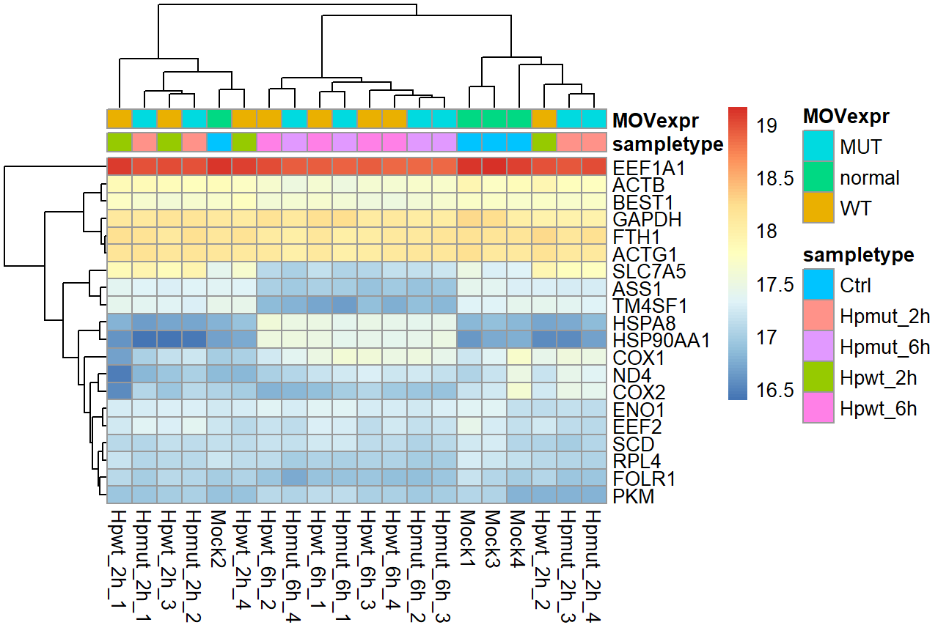
Results
Select top 20 most expressed genes

Slide 20
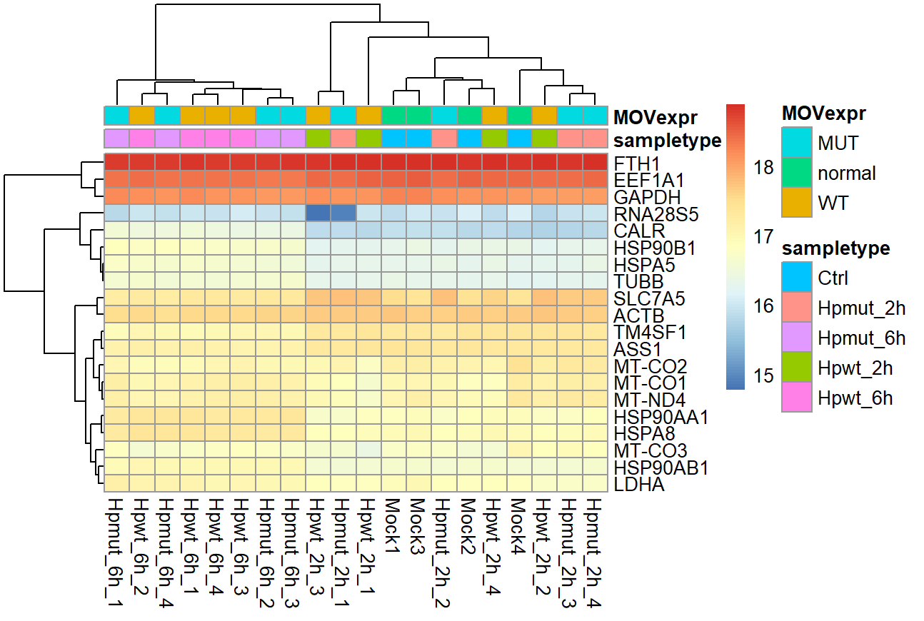
Results
Top 20 genes with most variance

Slide 21
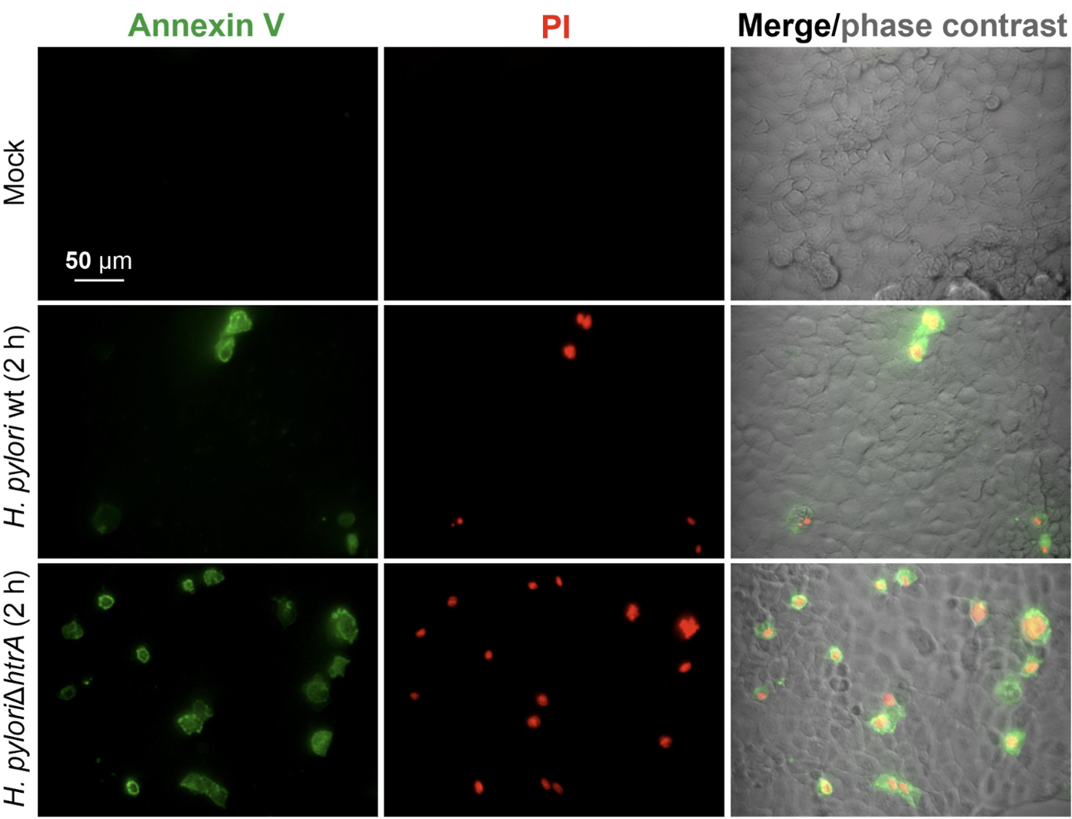
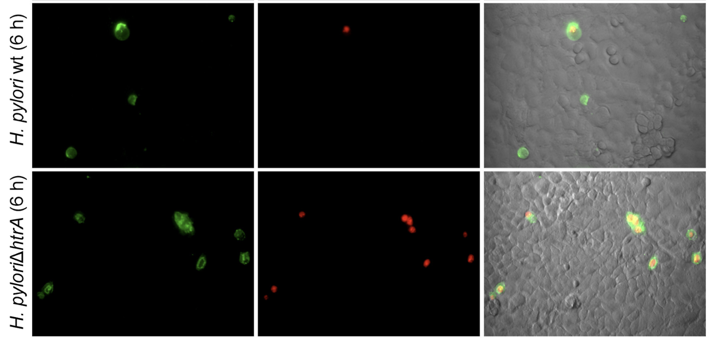
C) Epifluorescence microscopy of MKN-28 cell monolayers infected with H. pylori wt or ΔhtrA mutant for 2 or 6 h and stained with annexin V and propidium iodide (PI) to visualize apoptotic (green) and necrotic (red) cells, respectively. The right panel shows the annexin V and PI staining merged with phase contrast imaging. Treatment with 200 μM H₂O₂ served as positive control.

Slide 22
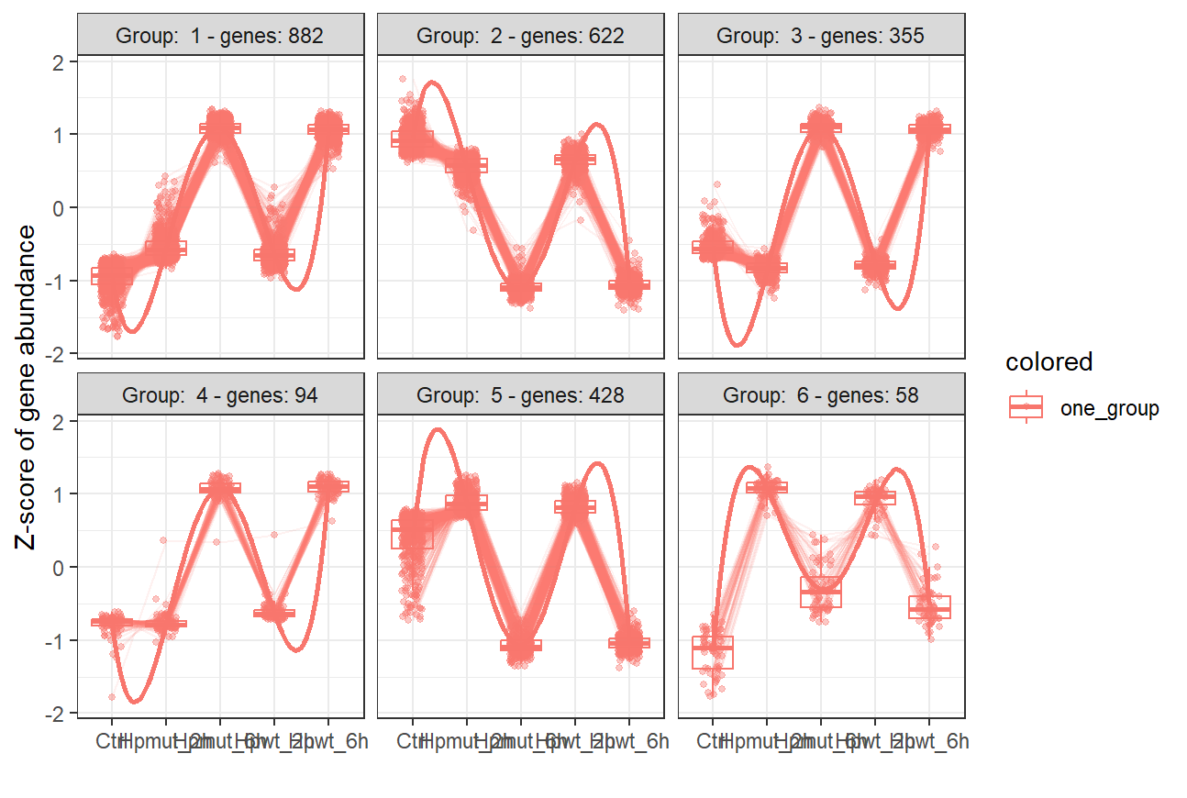
DGE analysis using LRT in DESeq2

Slide 23
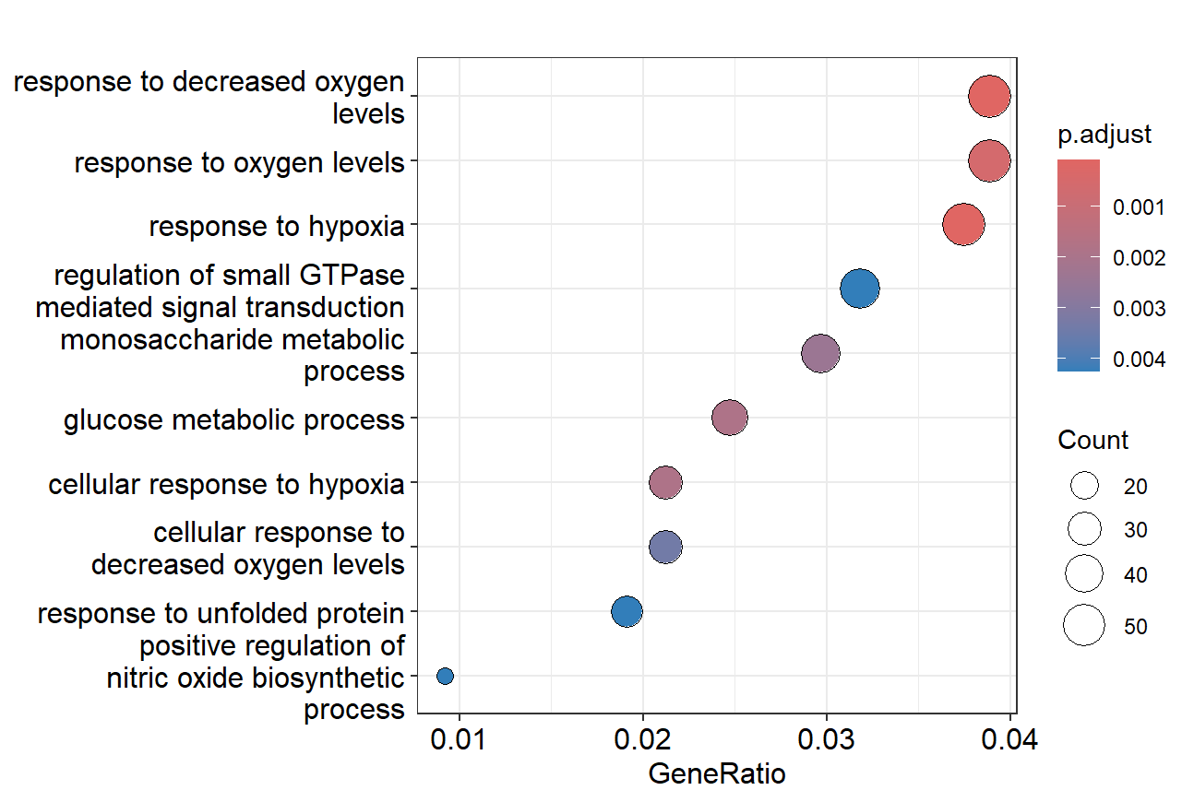
Gene Ontology (GO) term enrichment of biological pathways in MKN-28 cells affected after 6-h infection with H. pylori wt (adjusted p value < 0.05, log₂ fold change < −0.58 or >0.58)

